Slide 1

Information Systems Architectures
Martin Read

Slide 2
Overview
Recap & outline of materials
Servers
Cloud
APIs

Slide 3
Recap
COMP1004 – created SPA? Considered architecture?
Architecture = hazily defined notion
Represents how software designed
Deeply entwined with programming (COMP1000)
Shared understanding with other experts
Represents the things that are important
Worth putting in effort to keep in good condition
Make or break your software
Notes:
Poor architecture is a major contributor to bad code smells, cruft. Prevents efficient and quick delivery of software and makes it difficult to maintain

Slide 4
Key Author/Reading
Martin Fowler
Packt series via Primo
AWS serverless
And more…

Slide 5
Information Systems
Think back to COMP1001
consider the hardware involved in your systems
What is most frequently used software?
Where does your software run?
How do you access it?

Slide 6
Components
Internet
Web Server*
Web Browser*
Web Pages*
Database Server
Notes:
Browsing the web requires three of these four components.
1. Web servers which store and provide access to websites.
2. Web browsers which request and display information to an individual.
3. Web pages which are the individual documents that web servers stores and web browsers
request.
There is more going on over the Internet than you browsing web pages however. There is data
being transmitted behind the scenes which your web application is making use of. This is
machine-to-machine communication and we shall look at this when we look at web-services.
Web servers are a specific piece of software that provides data or services to other computers.
It is publicly available at a set IP address. (We shall look at IP addresses later in this chapter).
This software receives requests for web page data and supplies it by sending it over the
Internet.
Web browsers are software that is used to retrieve the web page data so that a human being
can read it. The browser runs on an individual's device and communicates with the web
servers. These allow platform independent communication. The browser does not need to
know what type of software the server is running, because it is communicating only via the set
protocols - HTML and HTTP.
Web browsers establish a TCP/IP connection for each interaction they carry out - which is an
HTTP session. HTTP is not designed for real-time applications so web developers have to carry
out certain operations to get around this and may well use Web Sockets. We shall NOT be
using Web Sockets in this module, but I just wanted to highlight their existence so that you are
aware.
Web pages that are static do not make use of server-side code, nor are they connected to any
form of data storage. However, dynamic web pages usually are. Dynamic pages are where
server-side code hosted on the web-server runs to produce some new HTML output. The web
pages are accessed using URL's and IP addresses. We shall cover more on this later

Slide 7

Servers

Slide 8
Options
Physical server : someone is running the server
World-wide applications – server needs to adapt to loadings
Respond under heavy loads, many requests
Someone looks after the rack
Virtual machines : OS you access hosted on someone’s server
Allows you to use the physical resources somewhere else
Shares hardware resources
Functions separately from any other VM’s

Slide 9
Options .. Cont./
Containers : Allow applications running on an OS to be separated by running inside a container
A container holds only the application & any dependencies
Docker
Functions : as a service (FaaS)
Hardware, OS and application all managed by someone else
AKA serverless
Welcome to the cloud….

Slide 10

Cloud Native

Slide 11
Cloud Native
Cloud Native Computing Foundation (CNCF)
https://github.com/cncf/toc/blob/main/DEFINITION.md
Considers cloud native applications to be those that are broken down into microservices & containerized
Incorporates CI/CD
Continuous Integration
Continuous Development
Used in companies using Agile
Used in DevOps

Slide 12

Monolithic

Slide 13
Single Code Base
Original approach – often when learning
Front-end and back-end code combined
Database running on same machine
Consider limitations
How do you share the application?
How do you work with other members of a team?
How do your testers test the application?
How do your end users get their hand on the application?

Slide 14

Layered Architecture
N-tier
Presentation layer
Business layer
Data layer
Notes:
A useful book to read is “Patterns of Enterprise Architecture” by Martin Fowler. Found in the library here - https://primo.plymouth.ac.uk/permalink/f/1o21sji/44PLY_ALMA_DS2135660560001281

Slide 15
N-Tier
But still silos
”not my responsibility”
What about scaling?
Virtual machines have enabled n-tier
Software defined networking
Applications more secure by separating tiers of workloads
Databases can be hidden behind network boundary
Teams can be responsible for their own areas
DBAs maintain the databases
Developers deploy to web or presentation tier
Network engineers fine tune the delivery infrastructure

Slide 16
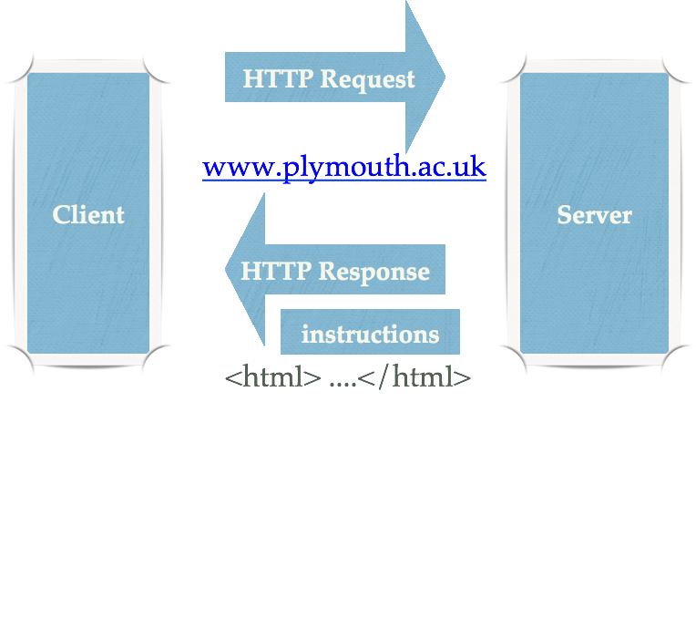
Client – server architecture is an important concept here
Notes:
A Client can be any type of machine that has a browser. Smart phone, laptop, tablet, desktop etc.
By typing in the URL you are making the browser create an http packet of data.
This is the HTTP Request.
The Server knows what to do with that request
It replies with a packet of data which has some instructions in it (headers) and the html that will display.
Our coding determines how the server creates that html

Slide 17
Micro-services

Slide 18
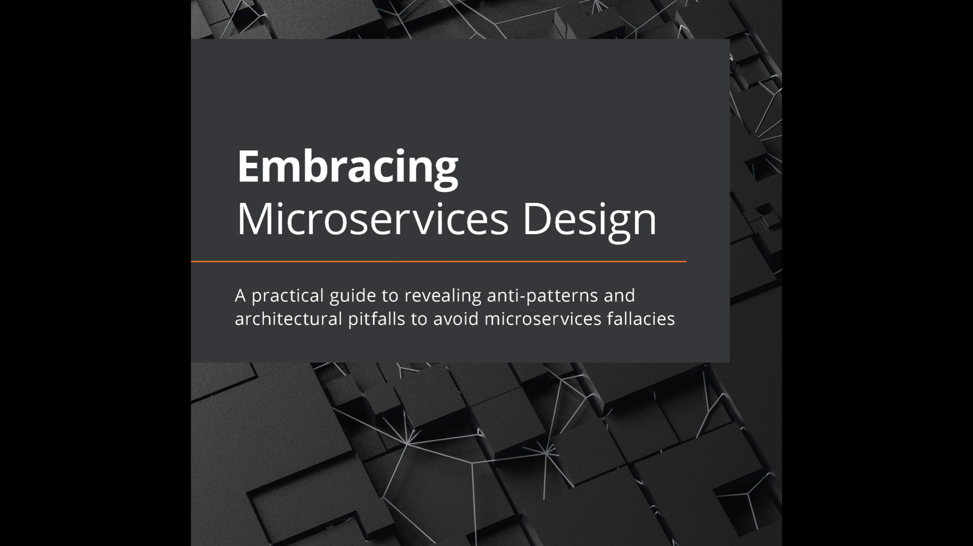
Recommended book from Pakt

Slide 19
Micro-services
Single responsibility principle
Challenges current culture, understanding and modelling
Looks at the domain – not the technology
Domain Driven Design (DDD)
Communicate via messaging over a network
Usually TCP/IP
Aim is to have loosely coupled, modular and isolated functionality

Slide 20
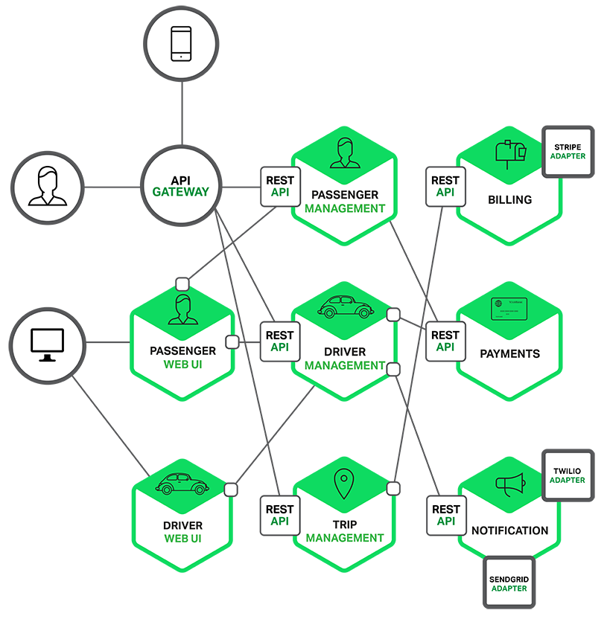
Micro-services
Each functional area of the application is delivered through it’s own microservice.
This allows more personalisation and customisation.
Do one thing and do it well
http://adicodes.com/microservices-introduction/

Slide 21
Key points
Domain-Driven design (DDD)
Single Responsibility principle
Encapsulation and interface segregation
Interfaces do not change – often an API gateway is used
Independently deployable
Not reliant on others in team/organization/etc
Automated
Embedded use of continuous integration/deployment/testing

Slide 22
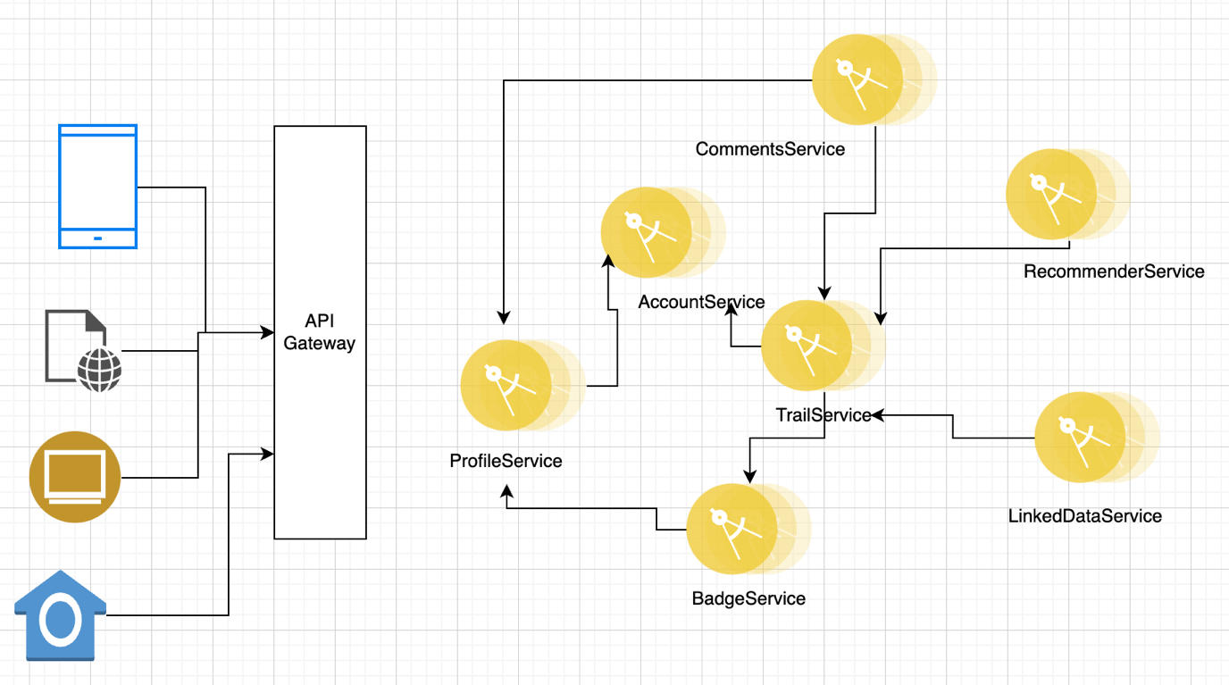
Assessment
Notes:
This will represent our intended architecture for the assessment. You need to look at what is expected within the different services.
Imagine that this is being hosted on a platform that will ensure high availability and that it already has orchestration within it. You don’t need to worry about that bit, it’s being done elsewhere.
Your focus is on one piece of the functionality within this. One micro-service.
The client consumes the services via the API gateway, message are relayed to the specific micro-service for processing. Different micro-services can use different data persistence approaches – you might have an SQL database, one might have an in-memory database and another might have a NoSQL database.
So you need to think about the messages that you need for your bit to work…

Slide 23
Activity
Reflect and consider what messages you think your micro-service will need to work!
10

Slide 24

Service-Oriented Architecture

Slide 25
SOA
Decouple an application and use HTTP as the communication mechanism
Break large complex applications down into clearly defined components
Developers build within a domain not a generic service
Deploy microservice independently using containers
Teams can work on their own SDLC
Driven by DevOps movement

Slide 26
Serverless
Smaller pieces of code deployed much faster
Developers focusing on coding functionality rather than worrying about the infrastructure
Code maps directly to business value
Developers now define the problem, build the business logic and deliver value to user
They aren’t provisioning the infrastructure
Or so they say…..

Slide 27
Mobile
Progressive Web Applications
Stored on device
Transferred later when in range or connected
Not always RDBMS
Key-Value pairs
Data and processing at same physical location
Not just found in mobile system
Notes:
Mobile applications are on the rise, many of us access data using a smartphone or a tablet.
Mobile applications can store the data on the device, for example iPhone uses SQLite. Data
can be stored on the device and then transferred later when in range or a connection can be
made. However data stored on the device is not always stored in RDBMS format, for example
key-value pairs might be used, which is an approach that localstorage makes use of.
The iPhone SQLite is very similar to the HTML5 web storage and web SQL databases. These
were new options that came with the HTML5 specification. However, in this module we are only
looking at server-side data storage, not client side. These approaches for web storage can be
used for mobile applications that could run in a browser, but might not have a connection to the
Internet.
This would be a physical view of the architecture, but when you consider the logical view you
would represent the data storage as being separate from the processing. When considering the
development perspective, you would represent a database access object for manipulating the
data. Database Access objects (DAO) will be covered later in the module

Slide 28

Modern applications

Slide 29
Event-Driven Architectures
Applications subscribe and react to changes in a wider eco-system
Event-sourcing : a model for storing the changes of state that a system goes through
Stream processing : consumption of these changes for further processing or storage

Slide 30
RESTful API’s
Are the front of the micro or nano-service
Use the HTTP Request / Response mechanism
Care to be taken not to closely couple them together
Does one have to wait until another gives it a successful response?
Or does it gracefully degrade the service?
Can the originating service roll back any state change if a transaction is interrupted?
Aim is to have loosely coupled services

Slide 31

Experience of APIs?
Notes:
And now let’s consider the infrastructure we have

Slide 32
Web Server
HTTP Response
HTTP Request
Web Browser
Notes:
Sometimes there are problems loading up the web page. This can be due to a slow connection
to the Internet from the client perspective or the server perspective. It could be that there is a
slow connection where the server is located and so you might want to problem solve by
identifying where traffic is heavy or identifying if the server is overloaded. You can test
connections with an online speed tests, for
example http://speedtest.comcast.net, www.cnet.com/internet-speedtest,
www.dslreports.com/speedtest?flash=1
Anything sent over HTTP is in the clear and as such can be intercepted. To get around this you
might well use HTTPS which is a secure encrypted connection between the web browser and
the web server. The two endpoints exchange an encryption key which then enables the
encryption of all future communication between them. You as the end-user see HTTPS in your
browser bar and sometimes the browser can give you some other clues as to whether this is in
use or not. From the development perspective, all sites that use this have a digital certificate
which validates the site as being trustworthy. The certificate is issued by a third party and has to
be renewed on an annual basis. You can view certificates if you click the padlock symbol or
other indication in the URL bar.

Slide 33

URLs
Servers will be set up to serve a default file name. IIS usually has either default or index.
You can register different file extensions depending on the languages installed on the server (eg: php, aspx)
Expected file extension will be html
Uniform Resource Locator
A URI that starts with http://
Location of the resource
http://www.plymouth.ac.uk:8080/ISAD251/Demo.php
protocol
domain
port
filename
path

Slide 34
URIs
Uniform Resource Identifier
URI is text to identify any resource or “thing” on the Internet.
Every URL is a URI but not vice versa

Slide 35
IP Addresses
The unique numerical address that identifies a computer on the Internet.
Part of TCP/IP protocol
Dynamic or static allocation
Internet of things!

Slide 36
Assignment infrastructure
dist-6-505 and Web.socem
Both virtualized servers, but run by SOCEM technician
Backed up by technicians
In the cloud, but not cloud
Set exercises require use of Microsoft SQL Server
Task 1 of part 2 coursework also on Microsoft SQL Server
Hosted API
Task 2 is not an RDBMs application

Slide 37
Model-View-Controller

Slide 38
Model-View-Controller
Enforces “Separation of Concerns”
Ensures components organised to support specific functionality with as little overlap as possible
Model
Controller
View

Slide 39

Model
Keep model focused on data logic
Data objects
Access database as required
Perform operations on data
View
Keep views focused purely on presentation
Interface to model
Display to end user
HTML etc
Controller
Keep controllers focused on application flow
Actions to change state of model
Consult models
Provide dynamic data to views

Slide 40
Models
Code First Entity Framework
POCO (Plain old CLR (Common Language Runtime) Object
DbContext classes
Business, Validation and data access logic
Use repository pattern to isolate data access logic from rest of application (EF = a type of repository pattern)

Slide 41
Views
Public face of the application
Render the HTML pages
Can be scaffolded from Controllers in ASP.NET MVC
ASP.NET MVC uses HTML helpers to render the HTML
A method that returns a string
You can use just plain HTML

Slide 42
Controllers
Responsible for controlling the flow of application execution
ASP.NET MVC Controllers respond to the browser request
Controllers expose one or more actions
Views
Files
Redirect

Slide 43

Any Questions?

